Slide 1
Epidemiology

Slide 2
Approaching Epidemiology
History
Public Health Surveillance
Descriptive Epidemiology
Ethics of Epidemiology
Analytical Epidemiology

Slide 3
History: Background facts
Descriptive Epidemiology: Person, place, time
Analytical Epidemiology: Dates, statistics
Ethics of Epidemiology: Laws (ex. Blood bank testing, bleeding in sports)
Public Health Surveillance: Solutions (what have we tried and is it working)

Slide 4
So what qualifies as Epidemiology???
Epidemiology looks at causation. Anything affecting human life.
Homicides
Suicide (more common than car accidents deaths)
Gang violence
Poverty
Drugs
Bullying
Infectious Disease
Food/ water borne diseases
Mental illness
Addiction
Car accidents
Media influence
Cancer
Absent family members
Teen pregnancy

Slide 5
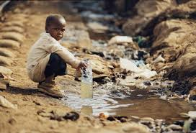
Fact
2.5 Million children die each year in Africa from contaminated water
Homicides in America predominantly target African American males ages 15-24 and are often caused by the same group
This ties directly to poverty, gang violence, drugs, and absent family

Slide 6
Shows real time outbreaks
www.healthmap.org/en/
Why care?
https://www.youtube.com/watch?v=2HryugTtcyE

Slide 7
Solving Health Problems
Step 1 -
Step 1
Step 1 -
Data
collection
Surveillance; determine time, place, and person
Step 2
Step 2
Solving health problems
Assessment
Inference
Step 3
Step 3
Hypothesis
testing
Determine how and why
Step 4
Step 4
Action
Intervention
Action
Notes:
SAY: To solve health problems, epidemiology practitioners, or epidemiologists, use a four-step scientific approach that includes
data collection,
assessment,
hypothesis testing, and
action.
When using the scientific approach, data are collected, and an initial assessment (or hypothesis) is conducted. The hypothesis is then tested, and the resulting information is used to take action.
<DIRECT participants to the boxes on the far right.>
This portion of solving health problems illustrates how the epidemiologist uses each step in the scientific approach.
First, data are collected about health problems occurring among the population through public health surveillance. The data collected include information about when the problem occurred, as well as where and who were affected (that is, time, place, and person). This is known as descriptive epidemiology, and it will be covered in greater detail later in the course.
Next, the epidemiologist establishes inferences on the basis of the collected data and draws initial conclusions on the basis of those data. From there, he or she uses the information to generate hypotheses about what might be causing the health problem.
Then, the how and why of a condition is determined by conducting tests or studies to determine if the hypothesis is accurate. This determination of how and why is known as analytic epidemiology, which will also be covered later in this course.
Finally, the epidemiologist takes action. In public health, that action is known as an intervention. We take action to intervene to prevent the condition from spreading further or to promote healthy behaviors. The epidemiologist recommends or implements some form of action at the population level (for example, a community intervention.)
<Instructor note: Add your own example of hypotheses and interventions.>
GO to next slide.

Slide 8
Epidemiology Key Terms
epidemic or outbreak: disease occurrence among a population that is in excess of what is expected in a given time and place.
cluster: group of cases in a specific time and place that might be more than expected.
endemic: disease or condition present among a population at all times.
pandemic: a disease or condition that spreads across regions.
rate: number of cases occurring during a specific period; always dependent on the size of the population during that period.
Notes:
SAY: Now that we know what epidemiology is, let’s review some key terms commonly associated with the study.
You will see these terms throughout this course.
<READ the key terms and provide examples, if necessary.>
GO to next slide.

Slide 9
Knowledge Check
Match each term with the correct example.
A. endemic
B. pandemic
C. epidemic
A. endemic
Malaria is present in Africa at all times because of the presence of infected mosquitoes. Malaria is _____ in Africa.
C. epidemic
2. The Ebola virus in parts of Africa is in excess of what is expected for this region. This virus is a/an ________.
B. pandemic
3. HIV/AIDS is one of the worst global diseases in history. It is a/an _________.
Notes:
SAY:
<READ the first knowledge check question and wait for participant responses.>
<CLICK for the correct answer to appear.>
The correct answer is A, endemic.
<READ the second knowledge check question and wait for participant responses.>
<CLICK for the correct answer to appear.> SAY: The correct answer is C, epidemic.
<READ the third knowledge check question and wait for participant responses.> <CLICK for the correct answer to appear.>
SAY: The correct answer is B, pandemic.
GO to next slide.

Slide 10
Epidemiology Study Types
Experimental
Epidemiology study
types
Descriptive
Observational
Analytic
10
Notes:
SAY:
Now, let’s examine the different types of epidemiology studies.
In an experimental study, the investigators can control certain factors within the study from the beginning. An example of this type is a vaccine efficacy trial that might be conducted by the National Institutes of Health. In such a trial, the investigators randomly control who receives the test vaccine and who does not among a limited group of participants; they then observe the outcome to determine if it should to be used more widely.
In an observational study, the epidemiologist does not control the circumstances. These studies can be further subdivided into descriptive and analytic.
Descriptive epidemiology is the more basic of these categories and is fundamental to what epidemiologists do. In a descriptive study, the epidemiologist collects information that characterizes and summarizes the health event or problem.
In the analytic study, the epidemiologist relies on comparisons between different groups to determine the role of different causative conditions or risk factors.
GO to next slide.

Slide 11
Descriptive and Analytic Epidemiology
Descriptive epidemiology | Analytic epidemiology
When was the population affected? | How was the population affected?
Where was the population affected? | Why was the population affected?
Who was affected?
11
Notes:
SAY: Time, place, and person is the mantra of the epidemiologist. Another way of comparing descriptive and analytic epidemiology is to say that, during the descriptive process, we are concerned with
when the population was affected,
where they were affected, and
who specifically was affected.
From the observations gathered during the descriptive process, a hypothesis is generated about the causes of observed patterns and the factors that increase risk for disease or injury.
To test a hypothesis, epidemiologists must use an analytic epidemiology process in which they ask how and why the population was affected.
GO to next slide.

Slide 12
Fatalities Associated with Farm Tractors
In 1982, the number of farm tractor-associated deaths was described in terms of time, place, and person by using records from an existing surveillance system
12
Notes:
SAY:
Let’s look at an example.
In 1982, an epidemiologist in the Georgia Department of Public Health became interested in the number of deaths associated with farm tractors. He determined he could examine this problem by using readily available data — death certificate records that were included in an existing surveillance system. He obtained the death certificate records for all deaths that had occurred in Georgia during 1971 through 1981 that were associated with farm tractor incidents.
After collecting the data, he used the information to describe the problem in terms of time, place, and person and then generated a hypothesis for further study. We’ll talk about his hypothesis in a moment, but first let’s look at the descriptive epidemiology.
GO to next slide.

Slide 13
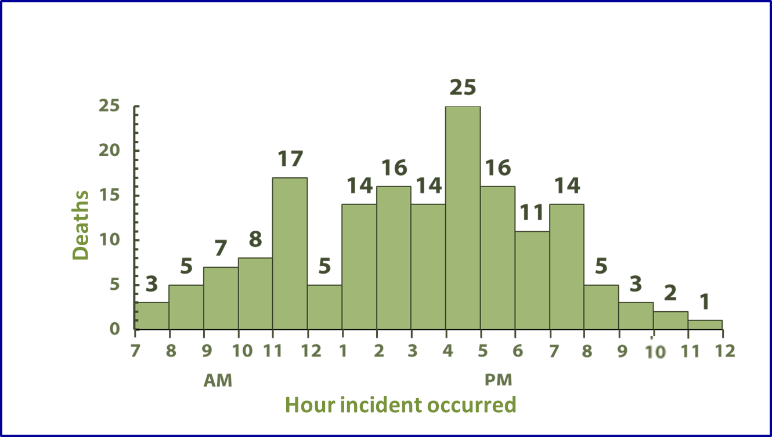
Fatalities Associated with Farm Tractors
Goodman RA, Smith JD, Sikes RK, et al. Fatalities associated with farm tractor injuries: an epidemiologic study. Public Health Rep 1985;100:329–33.
13
Notes:
SAY:
This graph describes the when for 166 of the farm tractor-associated deaths. We can examine the data by looking at the time of day when the deaths occurred.
What inferences can we make from this graph?
<CLICK for the first two arrows to appear.>
SAY:
Peaks in deaths occurred just before lunch and during late afternoon.
<CLICK for the third arrow to appear.>
SAY:
A decrease in deaths occurred from noon to 1:00 p.m.
We can infer that deaths occur when farmers are probably most fatigued right before lunch, which might lead to the increase in deaths in late morning. More deaths occur in late afternoon when children are home from school. Conversely, fewer deaths occur while the farmers are probably eating their lunch.
GO to next slide.

Slide 14
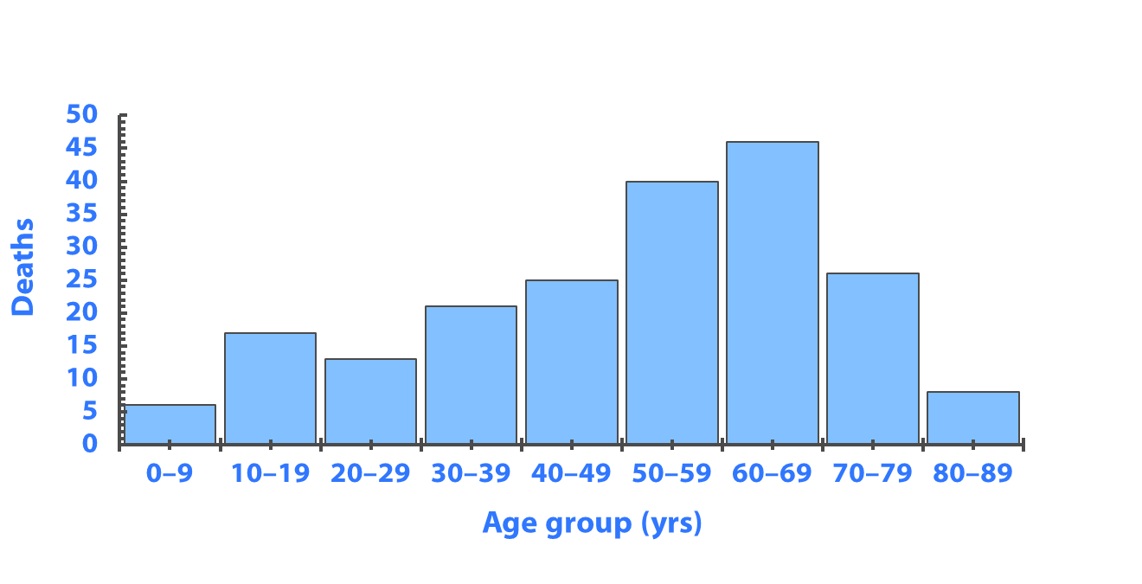
Fatalities Associated with Farm Tractors
Goodman RA, Smith JD, Sikes RK, et al. Fatalities associated with farm tractor injuries: an epidemiologic study. Public Health Rep 1985;100: 329–33.
14
Notes:
SAY: This graph describes the who. It indicates the number of deaths by age group.
What else can you infer from this graph?
<CLICK for animation to appear.>
SAY: An increase in the number of deaths occurred among older persons, which again, is part of the descriptive analysis.
<ASK: By analyzing these data, which age group is at greatest risk for death from tractor-related incidents among this population?>
<ELICIT answers from the participants.>
SAY: Unfortunately, you cannot tell. These are absolute counts of events, not rates. Without the population size for each age group, we cannot compare the relative risks.
Do the higher death numbers among persons aged 60 to 69 years reflect the fact that users of tractors are predominantly older? That older tractor users might be more likely to have an unintentional injury or less likely to survive an incident? We need to understand who is driving the tractor. Why do you think tractor-related deaths occur among the 0- to 9-year age group? Are children playing on tractors and fatally injuring themselves?
This example illustrates how descriptive epidemiology can be used to characterize a specific problem in terms of when, where, and who, and it can help generate a hypothesis for further study to answer how and why the problem occurs.
GO to next slide.

Slide 15
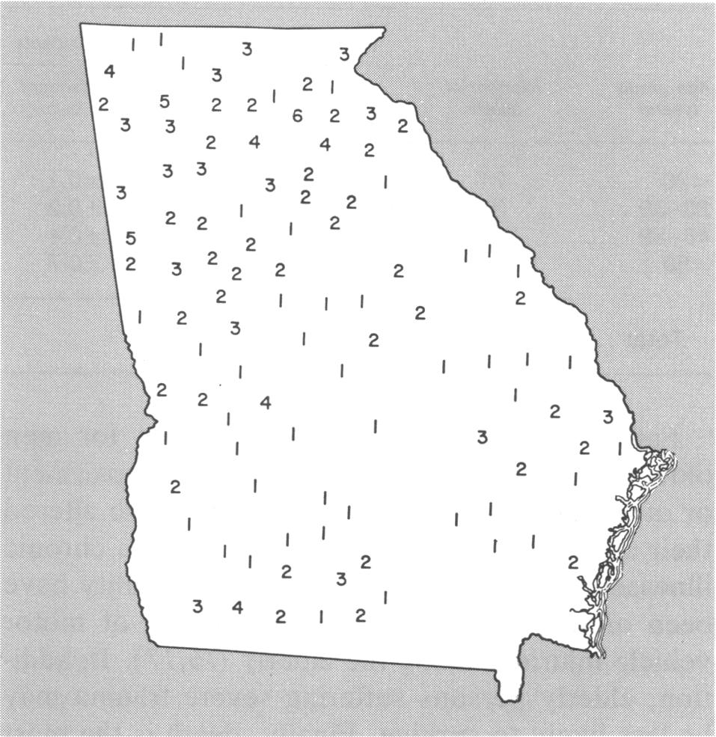
Fatalities Associated with Farm Tractors
Goodman RA, Smith JD, Sikes RK, et al. Fatalities associated with farm tractor injuries: an epidemiologic study. Public Health Rep 1985;100:329–33.
15
Notes:
SAY: This map describes where. It indicates the number of deaths by county (place) in Georgia.
<CLICK for animation to appear.>
Most of the deaths occurred in the northern areas of Georgia, which has a more mountainous terrain. Fewer deaths occurred in south-central Georgia, which is characterized by much flatter farmlands.
<ASK: What are some possible explanations for this geographic distribution?>
<ELICIT answers from the participants.>
<ASK: Can you infer that the distribution indicates that the rugged terrain is responsible for more tractor-related incidents?>
SAY:
Remember that the map indicates the number of deaths, not the rates. The numbers possibly reflect differences in population or the number of tractors being used. More farming occurs in south-central Georgia. Therefore, the number of tractors probably does not explain the difference. Perhaps geographic differences exist in the experience or skill level of those using the tractors.
GO to next slide.

Slide 16
Knowledge Check
Choose the correct answer from the following choices:
A. Qualitative
B. Experimental
C. Observational
C. Observational
An epidemiologist is doing a study on the sleep patterns of college students but does not provide any intervention. What type of study is this?
16
Notes:
<READ the knowledge check question and wait for participant responses.>
<CLICK for the correct answer to appear.>
The correct answer is C, observational.
GO to next slide.

Slide 17
Knowledge Check
Match each term to the correct example below.
A. Descriptive
B. Analytic
B. Analytic
A study of heart disease comparing a group who eats healthy foods and exercises regularly with one who does not in an effort to test association
A. Descriptive
2. A study to describe the eating habits of adolescents aged 13–18 years in Community X
17
Notes:
<READ the first knowledge check question and wait for participant responses.>
<CLICK for the correct answer to appear.>
The correct answer is C, analytic.
<READ the second knowledge check question and wait for participant responses.>
<CLICK for the correct answer to appear.> SAY: The correct answer is A, descriptive.
<READ the third knowledge check question and wait for participant responses.> <CLICK for the correct answer to appear.>
SAY: The correct answer is B, experimental.
GO to next slide.

Slide 18
Epidemiology Data Sources
and Study Design
18
Notes:
Topic 5
Epidemiology Data Sources and Study Design
SAY:
Next, we will discuss health-related and nonhealth–related data sources and the three types of study designs.
GO to next slide.

Slide 19
Data Sources and Collection Methods
Source | Method | Example
Individual persons | Questionnaire Survey | Foodborne illness outbreak CDC’s National Health and Nutrition Examination Survey Health data on U.S. residents
Environment | Samples from the environment (river water, soil) Sensors for environmental changes | Collection of water from area streams — check for chemical pollutants Air-quality ratings
Health care providers | Notifications to health department if cases of certain diseases are observed | Report cases of meningitis to health department
Nonhealth–related sources (financial, legal) | Sales records Court records | Cigarette sales Intoxicated driver arrests
19
Notes:
SAY:
We have covered definitions, key terms, and approaches to epidemiology. Let’s turn now to the sources epidemiologists use and the methods they use to collect data for studies.
How are the data from all of these sources collected? Here are some methods and examples for each of the main sources of data. Please note that this list is by no means exhaustive.
We often collect data from individual persons by using questionnaires and surveys.
Environmental data are collected in multiple ways. An epidemiologist might collect a sample of water from a stream to test for certain contaminants.
Health care providers collect considerable amounts of data during the course of daily clinical practice.
Data from nonhealth–related sources, such as financial and legal records, are gathered and reviewed from sales, court proceedings, arrests, and so forth. Examples of nonhealth-related sources that provide key data are cigarettes sales and the number of intoxicated driver arrests.
GO to next slide.

Slide 20
Conducting Studies
Studies are conducted in an attempt to discover associations between an exposure or risk factor and a health outcome
20
Notes:
SAY: After data are collected, hypotheses are tested, trends are evaluated, and factors between groups are compared.
By conducting studies, epidemiologists are attempting to discover if a causal association exists between an exposure or risk factor and a health outcome by making comparisons of factors between groups. For example, epidemiologists frequently compare data regarding ill persons with those of well persons. Or, the epidemiologist might compare data for a group of persons exposed to a risk factor with those who were not exposed to see if the outcomes are different for each group.
GO to next slide.

Slide 21
Study Design — Cross-Sectional Study
Subjects are selected because they are members of a certain population subset at a certain time
21
Notes:
SAY: To test hypotheses, three study designs are commonly used, including the cross-sectional, cohort, or case-control approach.
A cross-sectional study is similar to a survey in that it provides a snapshot of the population at a point in time.
Using this study, the epidemiologist defines the target population, then collects data from the population or a subset of the population at one specific point in time.
Participants are selected regardless of their exposure or disease status.
<Instructor note: Provide an example from your own experience.>
GO to next slide.

Slide 22
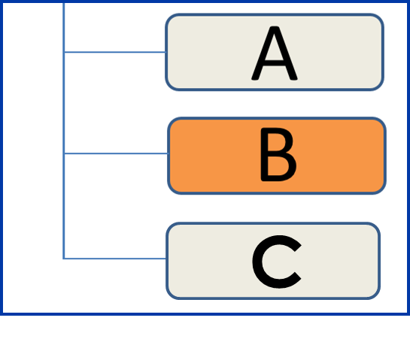
Study Design — Cohort Study
Subjects are categorized on the basis of their exposure to one or more risk factors
22
Notes:
SAY: In a cohort study, the epidemiologist selects a population, then categorizes each person by whether he or she was exposed to one or more risk factors of interest. Participants are followed over time to determine if a disease or condition develops.
<Instructor note: Provide an example from your own experience.>
GO to next slide.

Slide 23
Study Design Type — Case-Control Study
Subjects identified as having a disease or condition are compared with subjects without the same disease or condition
23
Notes:
SAY:
A case-control study compares one group who has a disease or health condition, referred to as case-patients, with a group that does not, referred to as control subjects.
The epidemiologist then works backward from the illness or health condition. Case-patients and control subjects are compared for the presence or absence of one or more specific exposures or risk factors. <Instructor note: Provide an example from your own experience.>
GO to next slide.

Slide 24
Knowledge Check
Which of the following are examples of a health-related source of data collection?
Intoxicated driver arrests.
Electronic health records.
Measurement of toxins in a river.
Medical board action against a physician.
Notes:
<READ the knowledge check question and wait for participant responses.>
<CLICK for the correct answers to appear.>
The correct answers are B, electronic health records and C, measurements of toxins in a river. GO to next slide.

Slide 25
Knowledge Check
Match each study with the correct definition.
A. Cross-Sectional
B. Cohort
C. Case-Control
C. Case-Control
1. Subjects with diabetes are compared with subjects without diabetes.
A. Cross-Sectional
2. A study of women aged 50–60 years in a community located close to a nuclear power facility.
B. Cohort
3. Subjects who have received nutritional counseling and who have exercised twice a week are compared with subjects who have not.
25
Notes:
<READ the first knowledge check question and wait for participant responses.>
<CLICK for the correct answer to appear.>
The correct answer is C, case-control.
<READ the second knowledge check question and wait for participant responses.>
<CLICK for the correct answer to appear.> SAY: The correct answer is A, cross-sectional.
<READ the third knowledge check question and wait for participant responses.> <CLICK for the correct answer to appear.>
SAY: The correct answer is B, cohort.
GO to next slide.

Slide 26
Topic 7
Investigating an Outbreak
26
Notes:
Topic 6
Investigating an Outbreak
SAY: Next, we will review the steps used to investigate an outbreak.
GO to next slide.

Slide 27
Outbreak Investigation
Ten steps are involved in outbreak investigations, including
establishing the existence of an outbreak
preparing for fieldwork
verifying the diagnosis
defining and identifying cases
using descriptive epidemiology
developing hypotheses
evaluating the hypotheses
refining the hypotheses
implementing control and prevention measures
communicating findings
27
Notes:
SAY:
Epidemiology is not a science conducted in a vacuum. Epidemiologists are in the field every day, putting their expertise to use.
One way epidemiologists apply their knowledge is by using the 10 steps involved in investigating an outbreak.
These steps include
establishing the existence of an outbreak,
preparing for fieldwork,
verifying the diagnosis,
defining and identifying cases,
using descriptive epidemiology,
developing hypotheses,
evaluating the hypotheses,
refining the hypotheses,
implementing control and prevention measures, and
communicating findings.
Only in theory do the steps proceed in order. In practice, they are adjusted, depending on the outbreak.
Let’s go through each of the 10 steps by using the Legionnaires’ disease example.
GO to next slide.

Slide 28
Outbreak Investigation — Steps 1 and 2
Step 1 — Establishing the existence of an outbreak
Use data from data sources
Step 2 — Preparing for field work
Research the disease
Gather supplies and equipment
Arrange travel
Fraser DW, Tsai, T, Orenstein W, et al. Legionnaires’ disease: description of an epidemic of pneumonia. New Engl J Med 1977;297 1189–97.
28
Notes:
SAY:
After such a substantial number of American Legion Conference attendees with similar symptoms were admitted to hospital emergency departments or examined in doctors’ offices, an initial investigation began.
During Step 1, epidemiologists were able to establish the existence of the Legionnaires’ disease outbreak by reviewing records and data from multiple sources that confirmed the disease cases — which were thought at the time to be pneumonia only — were indeed higher than normal from the previous weeks or months.
Step 2 involved preparing for field work by
researching the outbreak,
gathering necessary supplies and equipment, and
making travel arrangements.
The epidemiologists also consulted with other entities, such as health care workers and the local health department, to determine everyone’s role in the investigation and to learn who the local contacts would be after arriving on the scene.
GO to next slide.

Slide 29
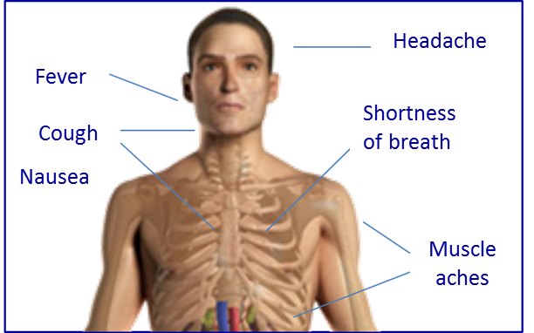
Outbreak Investigation — Steps 3 and 4
Step 3 — Verifying the diagnosis
Speak with patients
Review laboratory findings and clinical test results
Step 4 — Defining and identifying cases
Establish a case definition by using a standard set of criteria
Fraser DW, Tsai, T, Orenstein W, et al. Legionnaires’ disease: description of an epidemic of pneumonia. New Engl J Med 1977;297 1189–97.
29
Notes:
SAY:
During Step 3, the epidemiologists ensured that the problem was accurately diagnosed by
speaking with patients, and
reviewing laboratory findings and clinical test results.
After the diagnosis was established, a standard set of criteria, also known as a case definition, was established as Step 4 to determine whether a person should be categorized as having the disease or condition.
Four components typically are included in a case definition, including
1. Clinical information about the disease — What signs and symptoms have been observed?
2. Characteristics about the persons who are affected — Do any commonalities exist among those who have been ill?
3. Information about the location or place — Where are the affected persons located?
4. Specification of time during which the illness onset occurred — What date or time did the illness begin to occur, and what was the symptom duration?
During an outbreak, the case definition can evolve, typically becoming more specific as more information becomes available.
To assist epidemiologists in identifying early Legionnaires’ disease cases, public health nurses made rounds at local Philadelphia hospitals to gather data about those who became ill to verify the diagnosis. Meanwhile, laboratory samples and clinical examinations were tested and reviewed.
After the initial case definition was established, health care facilities — such as doctors’ offices, clinics, laboratories, and hospitals — were contacted to request that any observations of illnesses matching the case definition be reported.
GO to next slide.

Slide 30
Outbreak Investigation — Step 5
Step 5 — Using descriptive epidemiology
Describe and orient the data
Fraser DW, Tsai, T, Orenstein W, et al. Legionnaires’ disease: description of an epidemic of pneumonia. New Engl J Med 1977;297 1189–97.
30
Notes:
SAY:
Step 5 involved using descriptive epidemiology to describe Legionnaires’ disease and orient the data by identifying
what,
who,
where,
when,
why, and
how.
After these were identified, the epidemiologist proceeded to study the
dates,
times,
places, and
persons.
GO to next slide.

